Slide 1
Energiforsk Project: Lectures in the Power Plants
Fortum (Helsinki), TVO (Olkiluoto), Jan./Febr. 2024
Annual Energiforsk Seminar (10.11.21)
Vorlesungen Mechatronik im Wintersemester
Vibrations of Pumps in Nuclear Power Plants
Lecture IV Vibrations of Feedwater Pumps in Nuclear Power Plants
Rainer Nordmann
Technische Universität Darmstadt

Slide 2
Lecture IV Vibrations of Feedwater Pumps in Nuclear Power Plants
Vertical and Horizontal Pump Systems in Nuclear Power Plants
A typical Horizontal Feedwater Pump
Lateral Vibrations of the Horizontal Feedwater Pump
Modelling of the Horizontal Feedwater Pump with Interactions
Monitoring of the Horizontal Feedwater Pump OL3 during Operation
Vibration Phenomena of the Horizontal Feedwater Pump OL3
Measured and Calculated Vibrations of the Feedwater Pump OL3

Slide 3
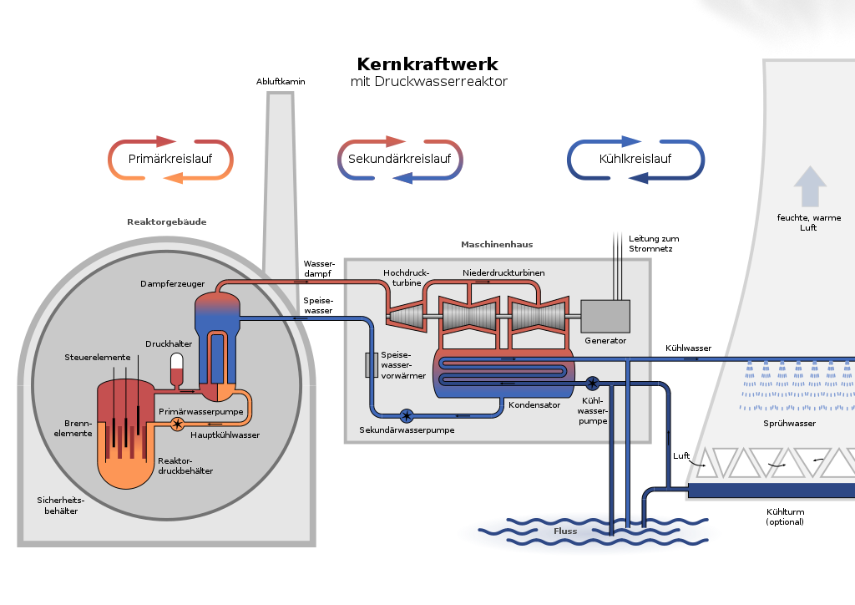
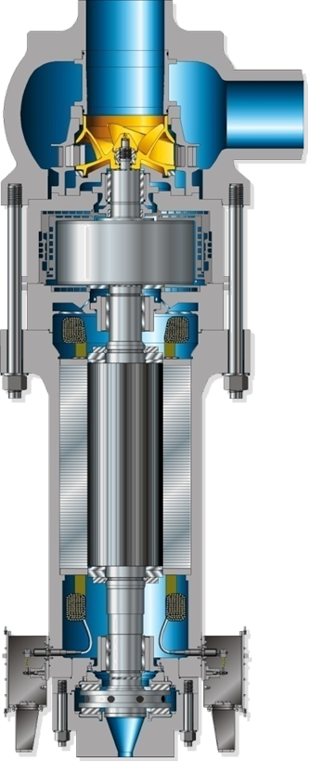
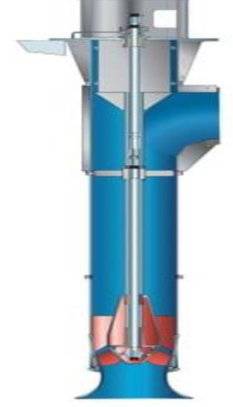
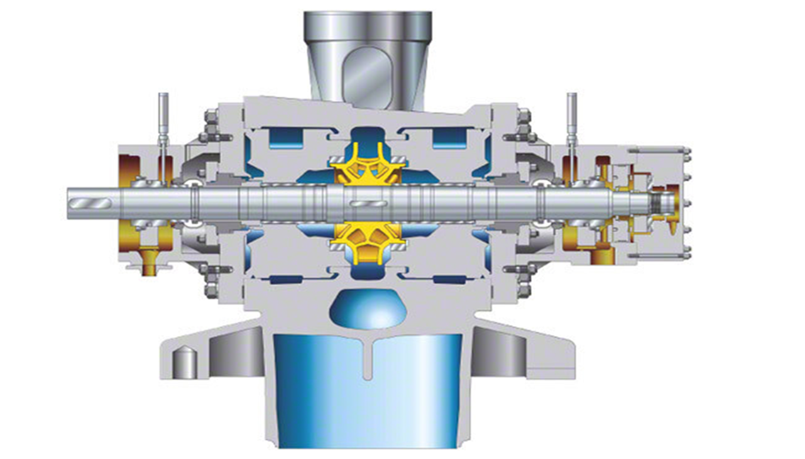
Vertical and Horizontal Pump Systems in Nuclear Powet Plants
Vertical Reactor
Coolant Pumps
Nuclear Power Plant
Pressurized Water Reactor
PWR PWR
Horizontal Vertical
Feedwater Pump Cooling Water Pump

Slide 4
Lecture IV Vibrations of Feedwater Pumps in Nuclear Power Plants
Vertical and Horizontal Pump Systems in Nuclear Power Plants
A typical Horizontal Feedwater Pump
Lateral Vibrations of the Horizontal Feedwater Pump
Modelling of the Horizontal Feedwater Pump with Interactions
Monitoring of the Horizontal Feedwater Pump OL3 during Operation
Vibration Phenomena of the Horizontal Feedwater Pump OL3
Measured and Calculated Vibrations of the Feedwater Pump OL3

Slide 5

A typical Horizontal Feedwater Pump
Cross Section with Main Components of the Horizontal Pump
Pump Casing and Pipe Impeller Seals
DE-Bearing Housing NDE-Bearing Housing with Radial 4-Lobe with Radial 4-Lobe
Oil Film Bearings Oil Film Bearings
Pump Shaft with
Double Flow Impeller Axial Oil Film Bearing
(Source: KSB Handbook) This Pump type is used in OL3

Slide 6
A typical Horizontal Feedwater Pump Pump Characteristics of the OL3 Feedwater Pump
Power 8000 KW
Capacity 4000 m3 /h
Pressure 124 bar
Temperature 176 °C
Rotational Speed 5589 rpm

Slide 7
A typical Horizontal Feedwater Pump Overview: Vibration Phenomena in the Horizontal Feedwater Pump
Vibrations of Horizontal Pumps
Fluid Dynamics & Mechanics
Strength of Materials
Stresses
Fracture Mechanics
Rotordynamics with
Interaction Effects
Unbalance Vibrations,
Critical Speeds,
Vibrations due to
Rotor Fluid Interactions and
Rotor Structure Interactions
Rotor Instability,
Whirl and Whip

Slide 8
Lecture IV Vibrations of Feedwater Pumps in Nuclear Power Plants
Vertical and Horizontal Pump Systems in Nuclear Power Plants
A typical Horizontal Feedwater Pump
Lateral Vibrations of the Horizontal Feedwater Pump
Modelling of the Horizontal Feedwater Pump with Interactions
Monitoring of the Horizontal Feedwater Pump OL3 during Operation
Vibration Phenomena of the Horizontal Feedwater Pump OL3
Measured and Calculated Vibrations of the Feedwater Pump OL3

Slide 9
Lateral Vibrations of the Horizontal Feedwater Pump
Motivation for Rotordynamic Investigations
How is the influence of time dependent Forces on the dynamic behavior of the Pump?
Which Motions of Vibration and which Internal Stresses act on
the rotating and on the non-rotating machine parts of the Pump?
Critical Conditions (Resonances, Critical Speeds, Instabilities)?
Can vibrations destroy machine parts?
Rubbing, Shaft and Impeller cracks, Bearing and Seal damages, large deformations,…
Which Interactions have to be considered?
Fluid Structure Interactions FSI (Impeller, bearings, seals),
Rotor Structure Interaction RSI (Pump casing)

Slide 10
Lateral Vibrations of the Horizontal Feedwater Pump
Lateral Vibrations, Dynamic Characteristics, Excitations
Lateral Vibrations: perpendicular to the
shaft axis with bending along the shaft line.
Physical Effects: Inertia (masses), stiffness
and damping of the system components including
Shaft, Impeller, Bearings and Seals.
Dynamic Characteristics: Lateral natural
frequencies, critical speeds, resonances, natural
modes, damping, stability,
Excitations:
Mech. & Hydr. Unbalance, with rotational frequency Ω,
Fluid forces at impeller with vane passing frequency NxΩ
Self excited vibrations, Instability in bearings and seals

Slide 11
Lecture IV Vibrations of Feedwater Pumps in Nuclear Power Plants
Vertical and Horizontal Pump Systems in Nuclear Power Plants
A typical Horizontal Feedwater Pump
Lateral Vibrations of the Horizontal Feedwater Pump
Modelling of the Horizontal Feedwater Pump with Interactions
Monitoring of the Horizontal Feedwater Pump OL3 during Operation
Vibration Phenomena of the Horizontal Feedwater Pump OL3
Measured and Calculated Vibrations of the Feedwater Pump OL3

Slide 12
Modelling of the Horizontal Feedwater Pump with Interactions
Input Output Relations for the Pump System
Vibrations of
Pump System
=
Dynamics of
Pump System
x
Excitation of
Pump Sytem
Output
Pump System
Input
Matrices M, D, G, K or
Natural frequencies
Damping
Mode shapes
Lateral Vibrations
Mech. & Hydr. Unbalance (Exc. Ω)
Fluid forces (Exc. NxΩ)
Self – Excitation, Instability

Slide 13
Modelling of the Horizontal Feedwater Pump with Interactions
Input Output Relations for the Pump System
Excitations F(t)
Mechanical Unbalance
Hydraulic Unbalance
Fluid Forces (Vane Passing)
Vibration Response x(t)
Mech. Unbalance Response
Hydraulic Unbalance Response
Response to Fluid Forces
Dynamic Characteristics of the Pump System:
Physical Parameters: Mass, Damping, Stiffness of Shaft, Impeller, Bearings, Seals
Modal Parameters: Natural frequencies, Damping, Natural modes

Slide 14
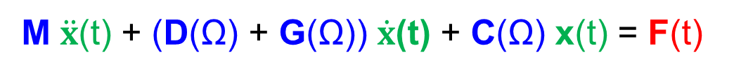
Modelling of the Horizontal Feedwater Pump with Interactions
Input Output Relations – Linear Equations of Motion
Excitations F(t)
Mechanical Unbalance
Hydraulic Unbalance
Fluid Forces (VanePassing)
Vibration Response x(t)
Mech. Unbalance Response
Hydr. Unbalance Response
Fluid Forces Respose
K(
K
The Equations of Motion of the Pump contain the stiffness & damping & mass data of the Shaft, Impeller, Bearings and Seals.

Slide 15
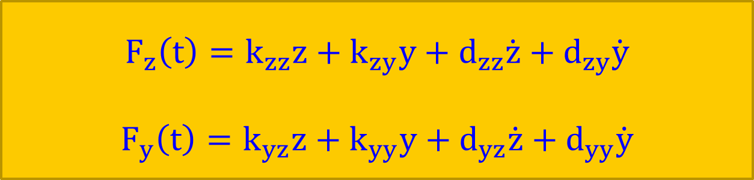
Modelling of the Horizontal Feedwater Pump with Interactions
Stiffness and Damping Coefficients of Fluid Film Bearings and Seals
The Forces of Fluid Film Bearings and Seals can be presented by stiffness and damping coefficients k_{ij} and d_{ij} in linear form:
They depend on the geometry (diameter, width, clearance) of the Bearings and Seals, on the physical fluid data (density, viscosity, temperature) and on the operating conditions (rotational speed, pressure, temperature, ..).
z, y are the coordinates in horizontal and vertical directions.
$$F_{z}\left(t\right)=k_{zz}z+k_{zy}y+d_{zz}\dot{z}+d_{zy}\dot{y}$$
$$F_{y}\left(t\right)=k_{yz}z+k_{yy}y+d_{yz}\dot{z}+d_{yy}\dot{y}$$

Slide 16
Modelling of the Horizontal Feedwater Pump with Interactions
Stiffness and Damping Coefficients of Fluid Film Bearings and Seals
The stiffness and damping coefficients of Fluid film bearings and Seals can be determined by Numerical calculations (CFD) or by Experiments.
For a bearing with a special geometry the coefficients depend on the Sommerfeld number So. Fluid film bearings have anisotropic behavior :
kzz ≠ kyy and dzz ≠ dyy
The coupling coefficients differ from each other: Unsymmetry
kzy ≠ kyz and dzy ≠ dyz
A measure for the instability sensitivity is the difference: (kzy – kyz).

Slide 17
Lecture IV Vibrations of Feedwater Pumps in Nuclear Power Plants
Vertical and Horizontal Pump Systems in Nuclear Power Plants
A typical Horizontal Feedwater Pump
Lateral Vibrations of the Horizontal Feedwater Pump
Modelling of the Horizontal Feedwater Pump with Interactions
Monitoring of the Horizontal Feedwater Pump OL3 during Operation
Vibration Phenomena of the Horizontal Feedwater Pump OL3
Measured and Calculated Vibrations of the Feedwater Pump OL3

Slide 18
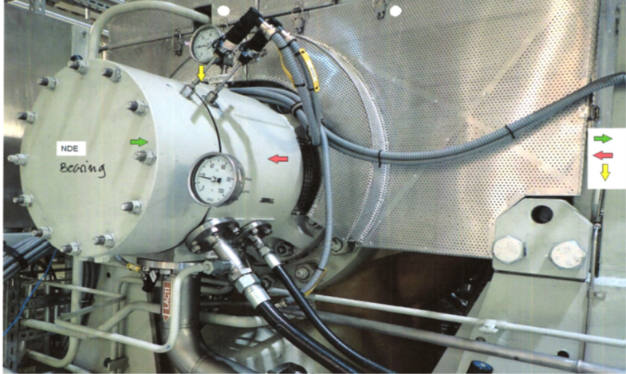
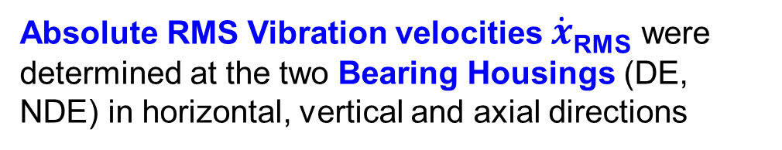
Monitoring of the Horizontal Feedwater Pump OL3 during Operation
Monitoring by means of absolute velocity measurements at Bearing Housings
NDE Bearing
Housing
DE NDE
Absolute RMS Vibration velocities $\dot{x}$_{RMS} were
determined at the two Bearing Housings (DE, NDE) in horizontal, vertical and axial directions

Slide 19
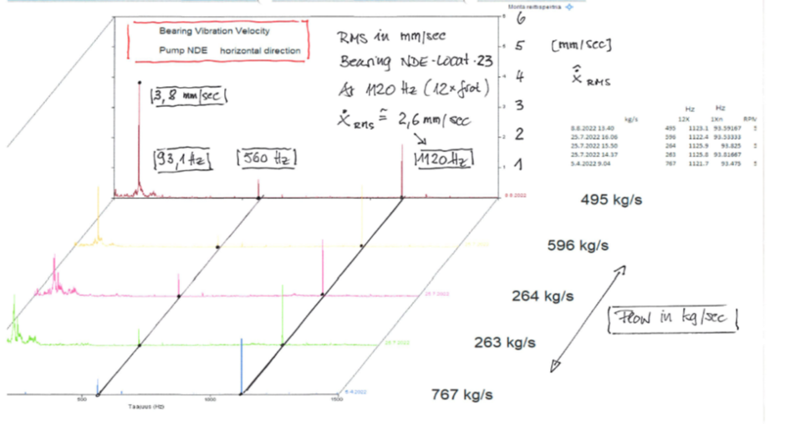
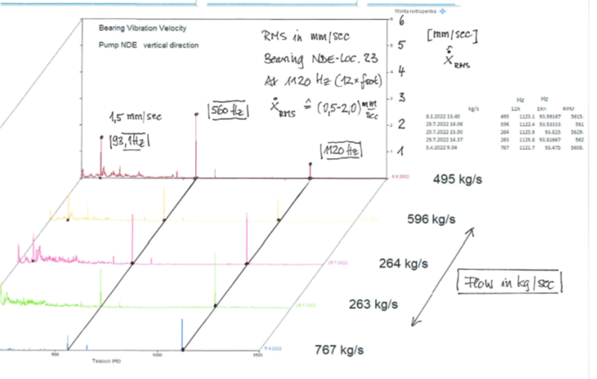



Monitoring of the Horizontal Feedwater Pump OL3 during Operation
Absolute RMS Bearing Vibration Velocities (mm/s) at NDE Bearing Housing
NDE Bearing horizontal $\dot{x}$_{RMS} (mm/s)
NDE Bearing vertical $\dot{x}$_{RMS} (mm/s)
$$\dot{\dot{x}\text{RMS}}$$
Flow Rate Flow Rate
93 Hz 560 Hz 1120 Hz 93 Hz 560 Hz 1120 Hz Frequency Hz
How can the vibrations at frequencies 93 Hz, 560 Hz & 1120 Hz be explained ?

Slide 20

Monitoring of the Horizontal Feedwater Pump OL3 during Operation
Absolute RMS Bearing Vibration Velocities (mm/s) at NDE Bearing Housing
NDE Bearing horizontal $\dot{x}$_{RMS}
How can the vibrations at frequencies
93 Hz, 560 Hz & 1120 Hz be explained ?
- 93 Hz : Vibrations due to Mech. &
Hydr. Unbalance Excitation with
Rotational Frequency Ω
- 560 Hz : Vibrations due to Vane Pass
Frequency Excitation (1. order)
- 1120 Hz : Vibrations due to Vane Pass
Frequency Excitation (2. order)
Flow Rate
93 Hz 560 Hz 1120 Hz Frequency Hz

Slide 21
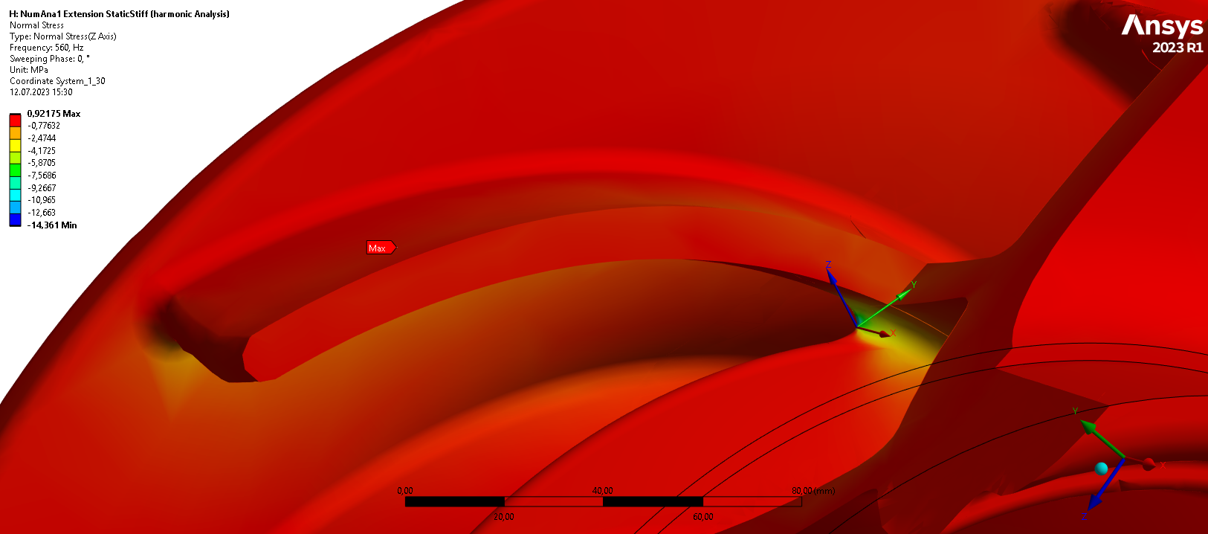
Monitoring of the Horizontal Feedwater Pump OL3 during Operation
Observation: Cracks in the Impeller at the sharp nose below the junction
Confirmation of high stresses
at the sharp nose below the
junction of the tangential blade
and the radial fin by FE calcul.
Observation of cracks in the
Impeller during an inspection
of the Boilerfeed pump in the
Commissioning phase of OL3.

Slide 22
Monitoring of the Horizontal Feedwater Pump OL3 during Operation
Observation: Cracks in the Impeller, initiated at the sharp nose below the junction
Beach marks

Slide 23
Monitoring of the Horizontal Feedwater Pump OL3 during Operation
FE Calculation: Confirmation of high Stresses at the location of the sharp nose

Slide 24
Lecture IV Vibrations of Feedwater Pumps in Nuclear Power Plants
Vertical and Horizontal Pump Systems in Nuclear Power Plants
A typical Horizontal Feedwater Pump
Lateral Vibrations of the Horizontal Feedwater Pump
Modelling of the Horizontal Feedwater Pump with Interactions
Monitoring of the Horizontal Feedwater Pump OL3 during Operation
Vibration Phenomena of the Horizontal Feedwater Pump OL3
Measured and Calculated Vibrations of the Feedwater Pump OL3

Slide 25
Vibration Phenomena of the Horizontal Feedwater Pump OL3
Damages in the Feedwater Pumps caused by which Vibrations?
The cracks in the Impeller have been detected already in the early phase of the Commissioning. At this phase the pumps were often operated with low Fluid Flows and relative high vibrations, which may have been the source of the cracks. Up to now further cracks have not been detected when the pumps are running under normal conditions with optimal Fluid Flow Q/Q_{opt.}
However, in the meantime another damage has been detected in the Impeller Seal Rings.
Up to now the source of both detected damages could not finally be identified. With respect to pump vibrations, possibilities are:
- Vibrations with 93 Hz due to mechanical and hydraulic Unbalances
- Vibrations with 560 Hz /1120 Hz due to Vane Passing Frequency Excitations.

Slide 26
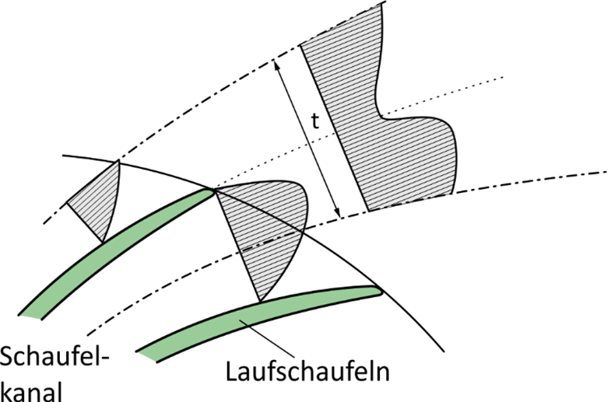
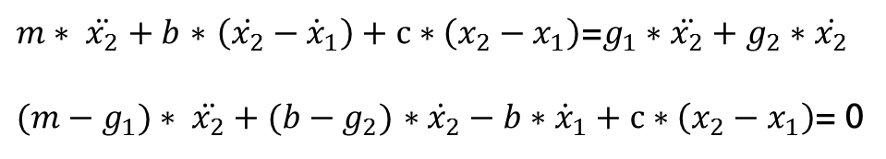
Vibration Phenomena of the Horizontal Feedwater Pump OL3
Vane Pass Frequency Excitation VPF
Vane
( N Impeller Blades)
This Fluid Structure Interaction (FSI) creates Fluid Forces in the area between the impeller and the volute with the Vane Passing Frequency VPF = f_{rot} x N and higher Harmonics of it.
f_{rot} = Ω/ 2π is the rotational frequency of the pump shaft in Hz and N is the number of blades.

Slide 27
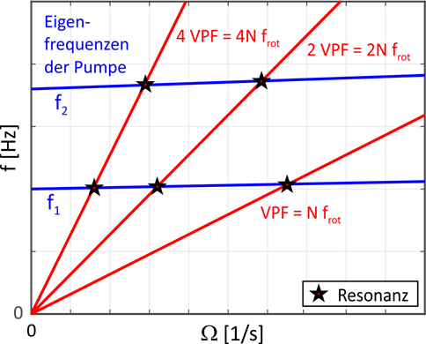
Vibration Phenomena of the Horizontal Feedwater Pump OL3
Example: Campbell Diagram with VPF Excitation lines and Natural Frequencies
In case of the Boiler Feed Pump OL3
f_{rot} = 93,2 Hz and N = 6
The Vane Passing Frequencies VPF are
VPF = 560 Hz and 2 VPF = 1120 Hz
In a Campbell Diagram we can find possible Resonances, when the speed dependent Excitation Frequencies VPF,
2 VPF, …(red lines) cross the lateral natural frequencies (blue lines).
To find the Resonances the lateral natural frequencies have to be determined.

Slide 28
Vibration Phenomena of the Horizontal Feedwater Pump OL3
Excitation due to Unbalances with Excitation Frequency Ω
The measured vibrations at the Feedwater pump OL3 show, that synchronous vibrations with angular velocity Ω (rotational frequency of the pump shaft) are also present in the frequency spectra.
Due to this fact Damages in the Feedwater Pumps OL3 may also be caused by Unbalance Vibrations.
There are three possible sources of Unbalance Vibrations:
- Mechanical Unbalance
- Unbalance due to a Shaft Bow
- Hydraulic Unbalance

Slide 29
Vibration Phenomena of the Horizontal Feedwater Pump OL3
Hydraulic Unbalance
There is always a portion of the Hydraulic Impeller Force which is
synchronous to the rotational frequency Ω. This hydraulic force behaves exactly the same way as a mechanical unbalance.
Hydraulic Unbalance Forces are caused by deviations from rotational symmetry of the fluid flow through the impeller channels (different blades and vanes, geometrical unequality, material roughess, fluid flow in the surroundings of the impeller).
Hydraulic Unbalance can also be amplified by Unequal Energy transfer due to different Cavitation behavior in different blades

Slide 30
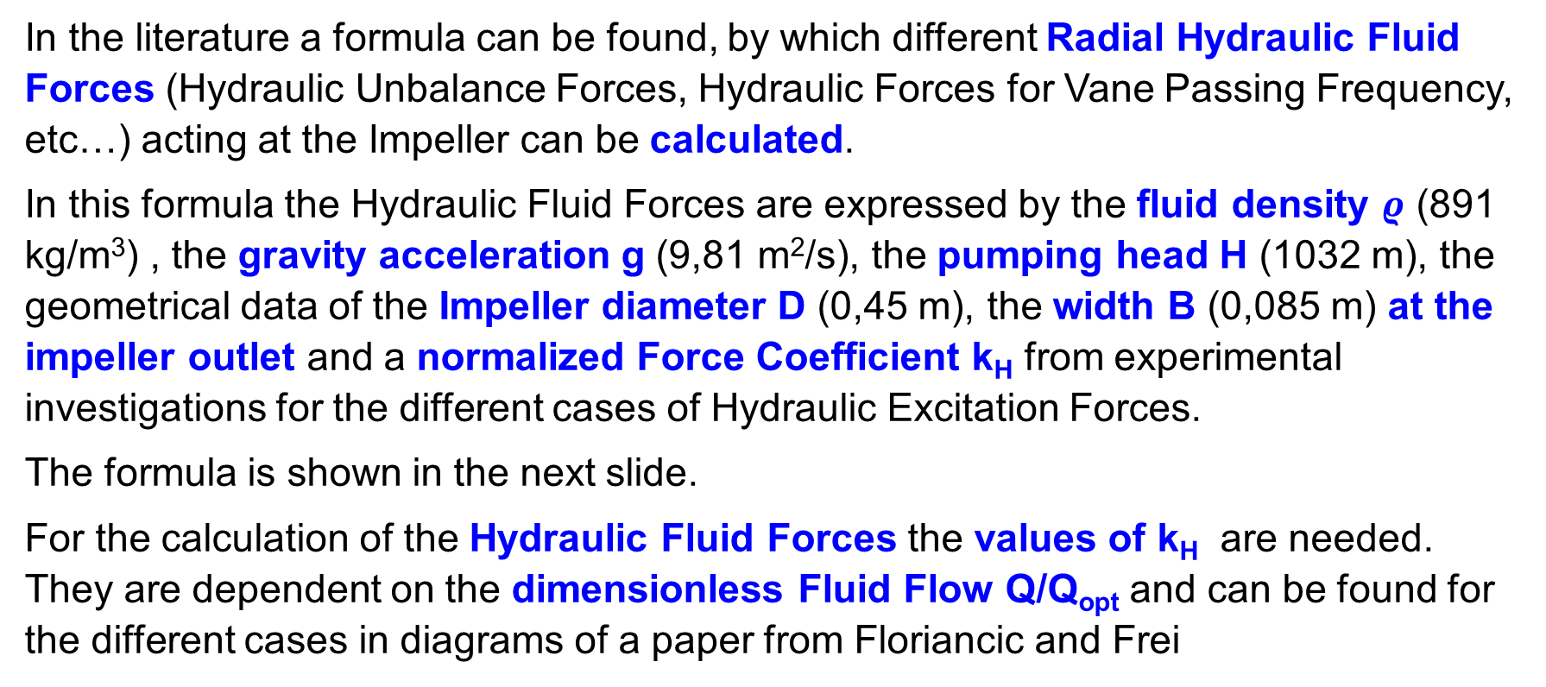
Vibration Phenomena of the Horizontal Feedwater Pump OL3
Hydraulic Excitation Forces expressed by a normalized Force Coefficient
In the literature a formula can be found, by which different Radial Hydraulic Fluid Forces (Hydraulic Unbalance Forces, Hydraulic Forces for Vane Passing Frequency, etc…) acting at the Impeller can be calculated.
In this formula the Hydraulic Fluid Forces are expressed by the fluid density $ρ$ (891 kg/m³) , the gravity acceleration g (9,81 m²/s), the pumping head H (1032 m), the geometrical data of the Impeller diameter D (0,45 m), the width B (0,085 m) at the impeller outlet and a normalized Force Coefficient k_{H} from experimental investigations for the different cases of Hydraulic Excitation Forces.
The formula is shown in the next slide.
For the calculation of the Hydraulic Fluid Forces the values of k_{H} are needed. They are dependent on the dimensionless Fluid Flow Q/Q_{opt} and can be found for the different cases in diagrams of a paper from Floriancic and Frei

Slide 31
Vibration Phenomena of the Horizontal Feedwater Pump OL3
Force Coefficient for Hydraulic Excitation Forces in Pump Impellers
The formula can be used to calculate different types of Hydraulic Radial Forces, acting at the impeller e.g. Hydraulic Unbalance Forces, Hydraulic Forces for Vane Passing Frequenies, etc….).

Slide 32
Vibration Phenomena of the Horizontal Feedwater Pump OL3
Normalized Force Coefficients for Hydraulich Forces (Sources from Literature)
Hydraulic Unbalance Vane Pass Frequency

Slide 33
Vibration Phenomena of the Horizontal Feedwater Pump OL3 Estimation of Fluid Forces for the case of Vane Pass frequency
The normalized Force Coefficients k_{H} for the case of Vane Pass Frequency Exciation are
for the Optimal case Q/Qopt = 1 : K_{H} = 0,05
for the part Load case, e.g. Q/Qopt = 0,3 : K_{H} = 0,10
For the two cases of Vane Pass Frequency Excitation the Fluid Force Amplitudes are
for the optimal case Q/Qopt = 1 : F_{H} = 17,25 kN
for the part Load case, e.g. Q/Qopt = 0,3 : F_{H} = 34,50 kN

Slide 34
Vibration Phenomena of the Horizontal Feedwater Pump OL3 Estimation of Fluid Forces for the case of Hydraulic Unbalance
The normalized Force Coefficient k_{H} for the case of Hydraulic Unbalance Excitation is
for the Optimal case Q/Qopt = 1 : K_{H} = 0,06
For the case of Hydraulic Unbalance Excitation the Fluid Force Amplitude is
for the optimal case Q/Qopt = 1 : F_{H} = 20 kN

Slide 35
Lecture IV Vibrations of Feedwater Pumps in Nuclear Power Plants
Vertical and Horizontal Pump Systems in Nuclear Power Plants
A typical Horizontal Feedwater Pump
Lateral Vibrations of the Horizontal Feedwater Pump
Modelling of the Horizontal Feedwater Pump with Interactions
Monitoring of the Horizontal Feedwater Pump OL3 during Operation
Vibration Phenomena of the Horizontal Feedwater Pump OL3
Measured and Calculated Vibrations of the Feedwater Pump OL3

Slide 36
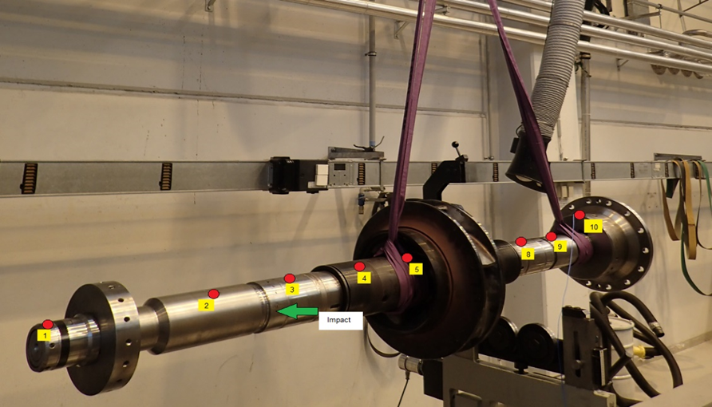
Measured and Calculated Vibrations of the Horizontal Feedwater Pump OL3
Determination of the Lateral Natural Frequencies of the Pump Shaft
      Test Set Up for Exp. Modal Analysis
        Pump shaft with Masses and Moments of Inertia of impeller, coupling and axial bearing in free free condition
        No bearings, no seals
        No rotation of shaft

Slide 37
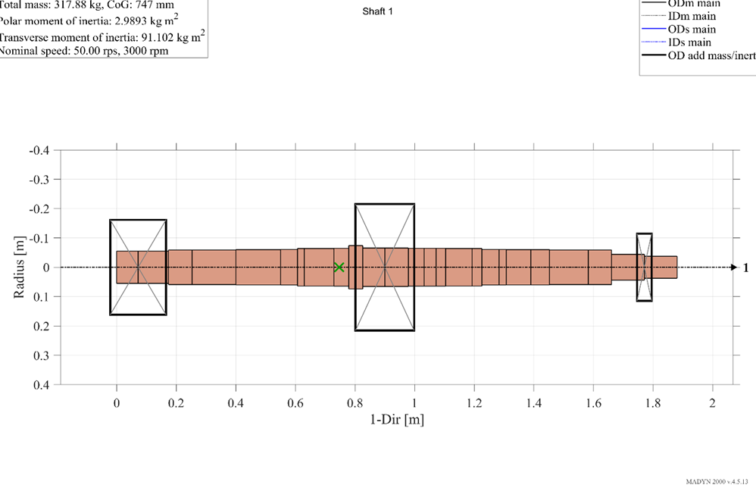
Measured and Calculated Vibrations of the Horizontal Feedwater Pump OL3 Determination of the Lateral Natural Frequencies by a FE- Model
      The FE Model consists of:
        Pump shaft (stiffness and mass of shaft)
        Masses and Moments of Inertia of impeller, coupling and axial bearing
        No bearings, no seals
        No rotation of shaft

Slide 38
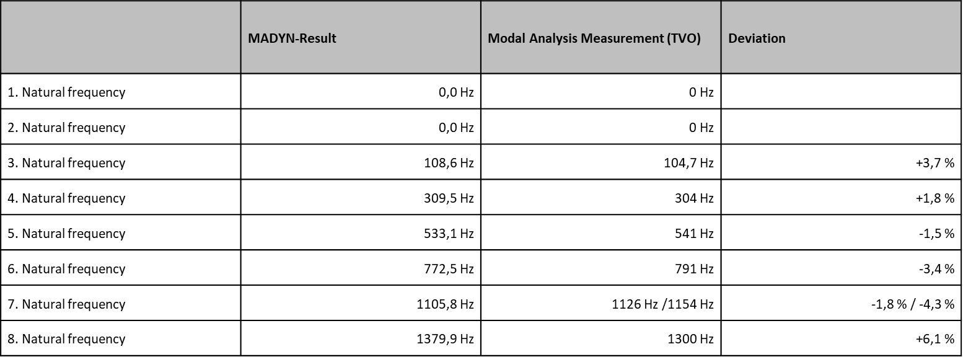
Measured and Calculated Vibrations of the Horizontal Feedwater Pump OL3
Comparison of the Natural Frequencies for the free-free pump shaft

Slide 39
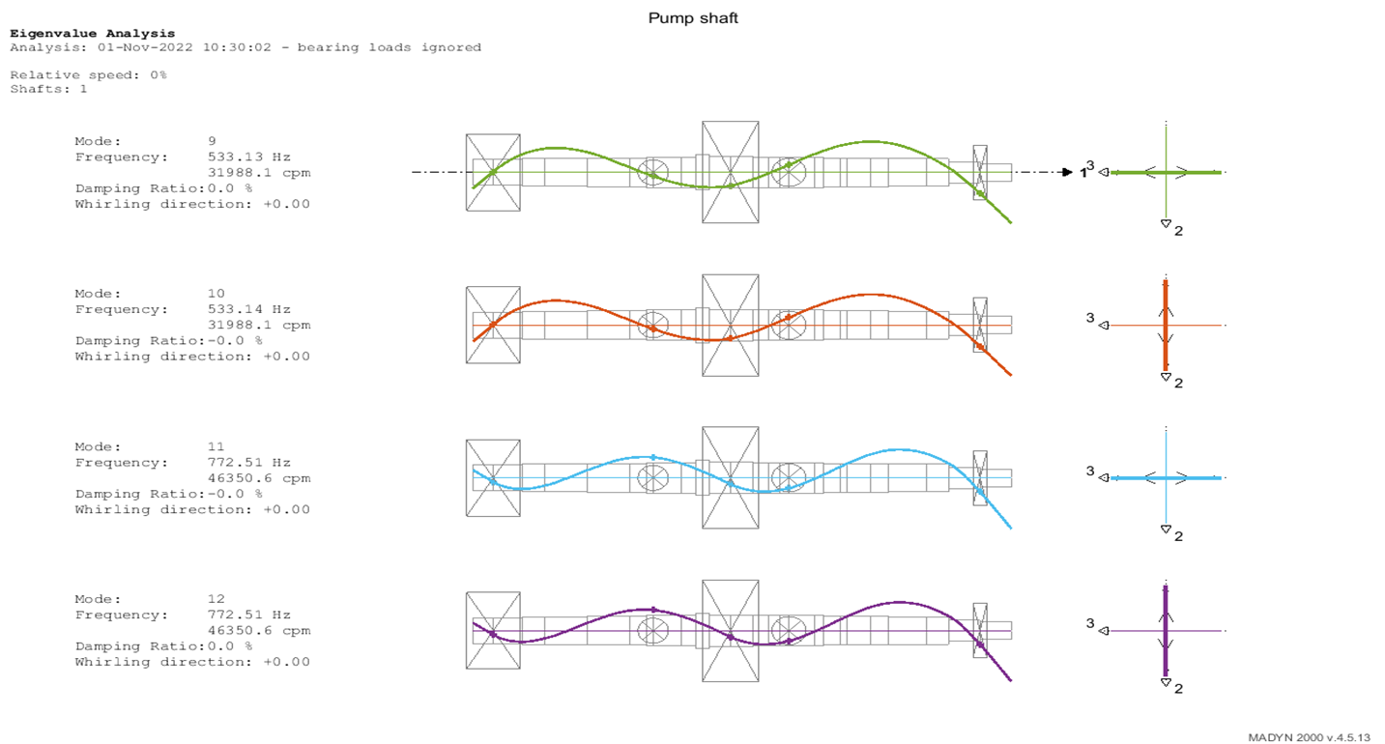
Measured and Calculated Vibrations of the Horizontal Feedwater Pump OL3 Mode Shape at 533 Hz for the free free Pump shaft
533 Hz

Slide 40
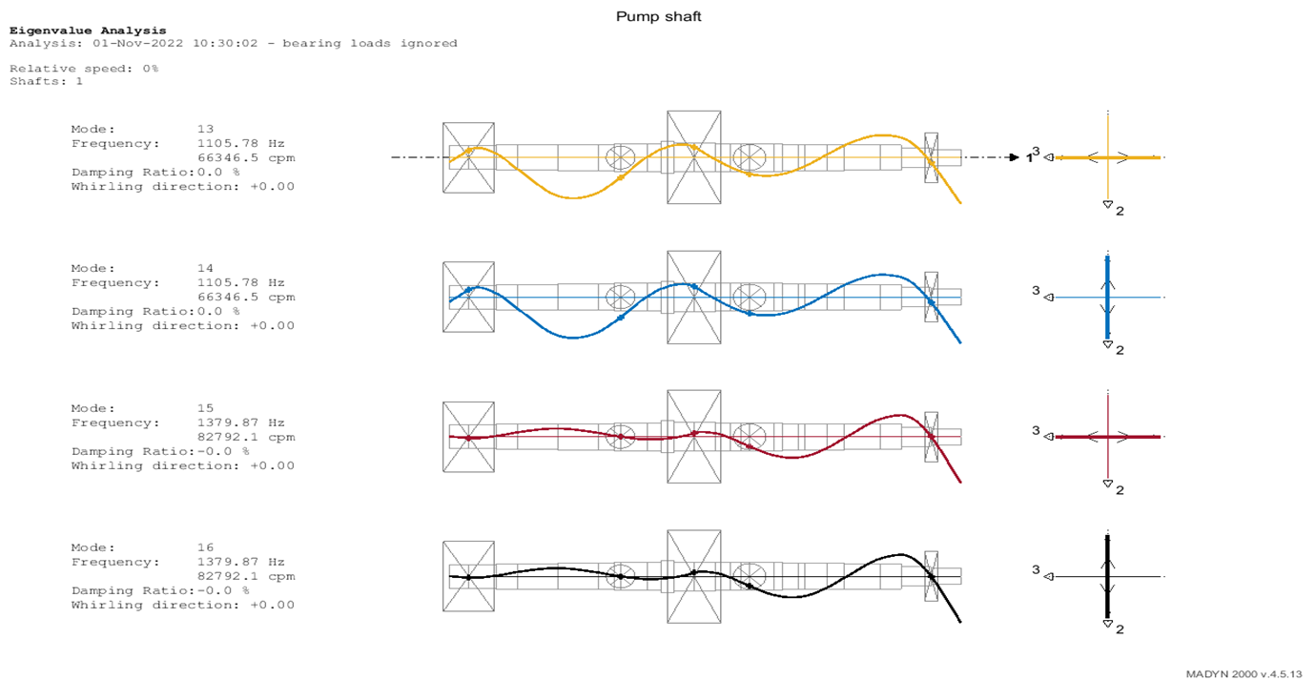
Measured and Calculated Vibrations of the Horizontal Feedwater Pump OL3 Mode Shape at 1105 Hz for the free free Pump shaft
1105 Hz

Slide 41
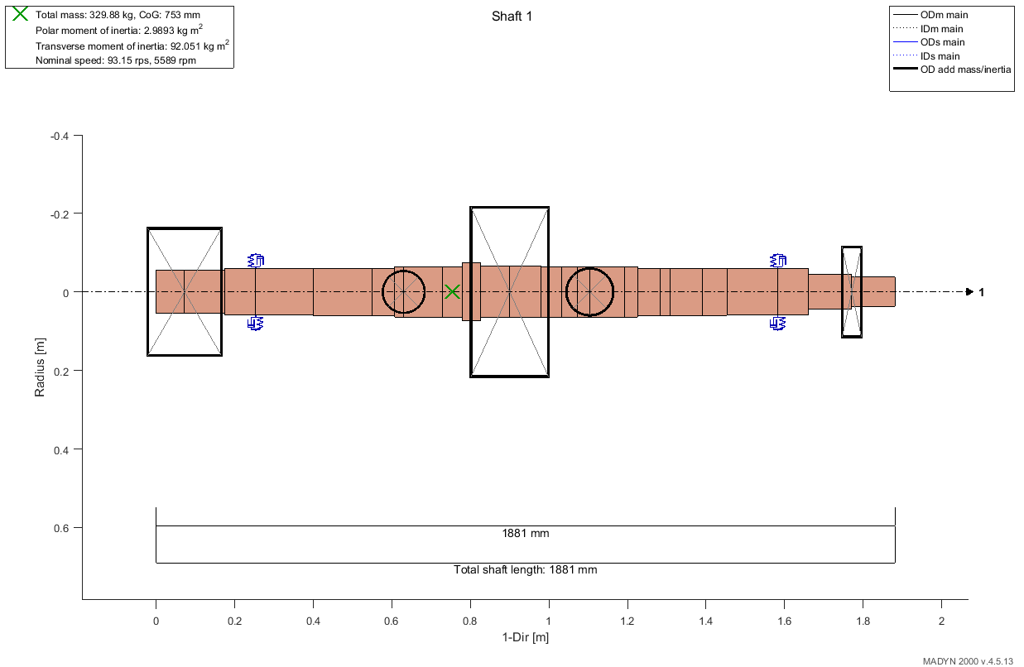
Measured and Calculated Vibrations of the Horizontal Feedwater Pump OL3 Determination of the Lateral Natural Frequencies by an extended FE- Model
      The extended FE-Model consists of:
        Pump shaft (stiffness and mass of shaft)
        Masses and Moments of Inertia of impeller, coupling and axial bearing
        Oil Film Bearings and Seals with speed dependent Stiffness and Damping Coefficients
        Rotation of the shaft

Slide 42
Measured and Calculated Vibrations of the Horizontal Feedwater Pump OL3 Determination of the Lateral Natural Frequencies by a FE- Model with all Effects
The influence of Bearings and Seals in the higher Frequency range is small.
The two first Bending modes at 125 Hz and 132 Hz are important, because they are close to the Rotational Frequency at 93 Hz. This may lead to high Unbalance Vibrations.

Slide 43
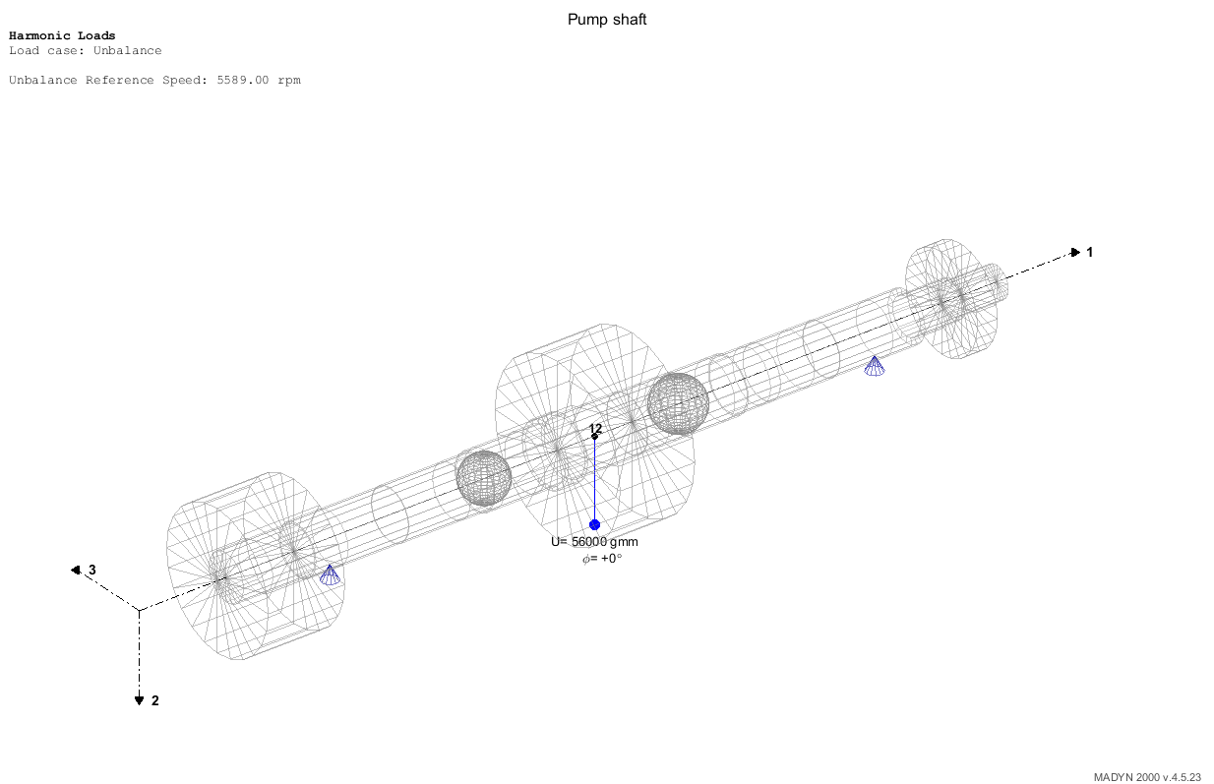
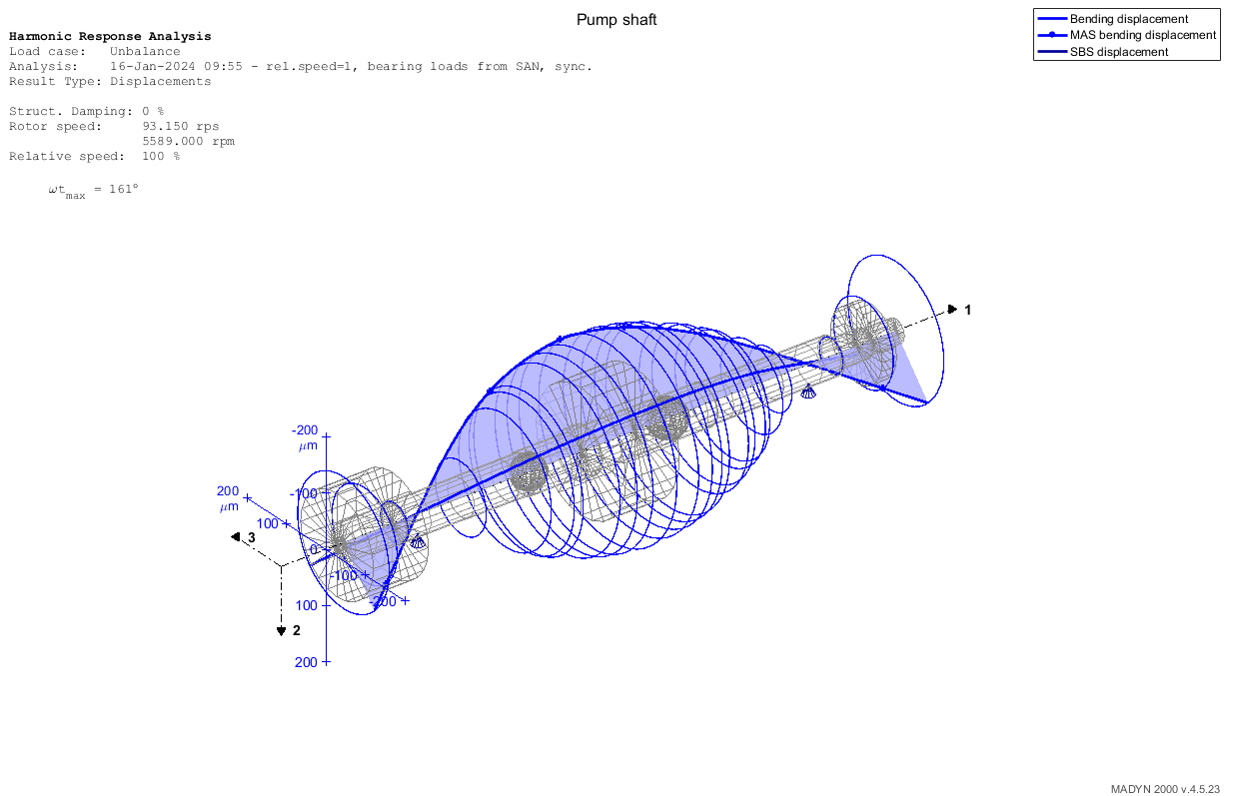
Measured and Calculated Vibrations of the Horizontal Feedwater Pump OL3 Vibrations of the Pump Shaft at Rot. Speed 5589 rpm due to Unbalace Force 20 kN
Unbalance Excitation Force 20 kN Shaft Vibrations at Impeller: 200 µm

Slide 44
Measured and Calculated Vibrations of the Horizontal Feedwater Pump OL3 Conclusions
Vibrations of the Boiler Feed Pump can strongly be excited by Fluid Forces with Vane Pass Frequency VPF of 560 Hz and 2 VPF = 1120 Hz. Resonances may occur at this Frequencies, because the Natural Frequencies of the Pump Shaft are close.
Under special flow conditions Fluid Forces at the impeller can be synchronous to the rotational frequency of the shaft.This hydraulic Fluid Forces behave the same way as a Mechanical Unbalances and are called Hydraulic Unbalances. They may be much larger than Mechanical Unbalances
The example of the Feedwater Pump OL3 shows, that the Unbalance vibrations may become large and have the potential to lead to damages.
.

Slide 45
Energiforsk Project: Lectures in the Power Plants
Fortum (Helsinki), TVO (Olkiluoto), Jan./Febr. 2024
Annual Energiforsk Seminar (10.11.21)
Vorlesungen Mechatronik im Wintersemester
Vibrations of Pumps in Nuclear Power Plants
Lecture IV Vibrations of Feedwater Pumps in Nuclear Power Plants
Rainer Nordmann
Technische Universität Darmstadt

