Slide 1
Energiforsk Project: Lectures in the Power Plants
Fortum (Helsinki), TVO (Olkiluoto), Jan./Febr. 2024
Annual Energiforsk Seminar (10.11.21)
Vorlesungen Mechatronik im Wintersemester
Vibrations of Turbines and Generators in Power Plants
Lecture II Torsional Vibrations of Turbogenerators due to SSR
Rainer Nordmann
Technische Universität Darmstadt

Slide 2
Lecture II Torsional Vibrations of Turbogenerators due to SSR
Mechanical Model for Torsional Vibrations of a Turbogenerator
Torsional Natural Frequencies, Modes and Damping of a Turbogenerator
Methods to predict Sub Synchronous Resonance
Monitoring of Torsional Vibrations and SSR – Incidents
Numerical Estimation of Torsional Vibration Torques and Stresses
Countermeasures to Control SSR- Problems

Slide 3
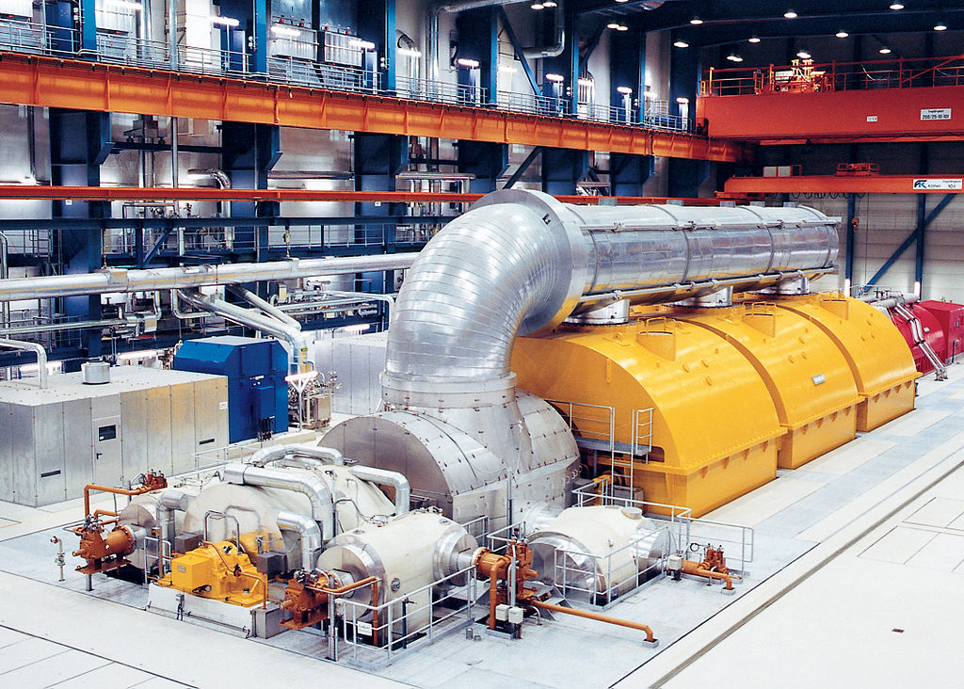
Mechanical Model for Torsional Vibrations of a Turbogenrator
Turbogenerator System with Mechanical Components
Generator
Pipe
System
Low Pressure
Turbines LPT
High Pressure
Turbine HPT
Turbogenerator System with Mechanical Components

Slide 4
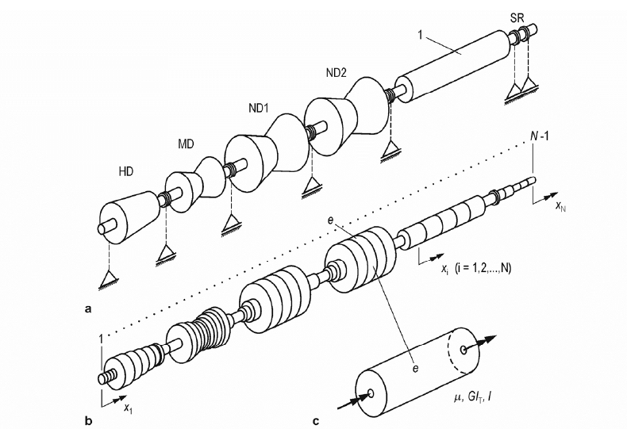
Mechanical Model for Torsional Vibrations of a Turbogenerator
Mass and Stiffness Distribution along the Shaft Train (Finite Elements)
The Mechanical Model of
a general Turbogenerator Shaft Train can be built up by means of the
Finite Element Method.
Each Finite Element will be
described by its length, the moment of inertia and the torsional stiffness.
Shaft
Finite Element

Slide 5
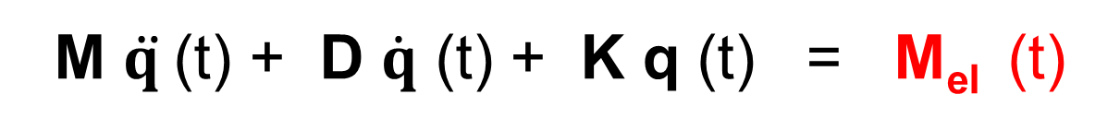
Mechanical Model for Torsional Vibrations of a Turbogenerator
FE-Model and Equations of Motion for Torsional Vibrations
M_{el}
HPT LPT1 LPT2 LPT3 GEN EXC
M $\ddot{q }$(t) + D $\dot{q}$ (t) + K q (t) = M_{el} (t)
The linear Equations of the Torsional Motion are built up of mass, damping
and stiffness matrices of the shaft train and the torque vector M_{eL}(t) due to
the Electro-mechanical Interaction in the Air Gap.
q (t) is the vector of the angular displacements.

Slide 6
Lecture II Torsional Vibrations of Turbogenerators due to SSR
Mechanical Model for Torsional Vibrations of a Turbogenerator
Torsional Natural Frequencies, Modes and Damping of a Turbogenerator
Methods to predict Sub Synchronous Resonance
Monitoring of Torsional Vibrations and SSR – Incidents
Numerical Estimation of Torsional Vibration Torques and Stresses
Countermeasures to Control SSR- Problems

Slide 7
Torsional Natural Frequencies, Modes and Damping of a Turbogenerator
Assessment of Torsional Vibrations in the Design – Eigenvalue Analysis
An Eigenvalue Analysis leads to the Torsional Natural Frequencies ω_{M}^{j} and to the corresponding Mode Shapes φ_{M}^{j} .The damping in the shaft train is low. Therefore the natural frequencies are not influenced by the damping: D = 0
(K - ω² ·M ) ·φ = 0
Torsional Natural frequencies ω_{M}^{j} Torsional Mode shapes φ_{M}^{j}

Slide 8
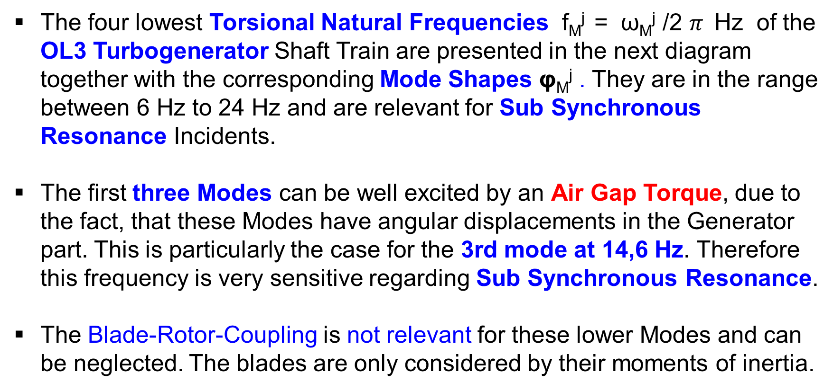
Torsional Natural Frequencies, Modes and Damping of a Turbogenerator
Lowest Torsional Natural Frequencies and Mode Shapes of OL3
The four lowest Torsional Natural Frequencies f_{M}^{j} = ω_{M}^{j} /2 $π$Hz of the OL3 Turbogenerator Shaft Train are presented in the next diagram together with the corresponding Mode Shapes φ_{M}^{j} . They are in the range between 6 Hz to 24 Hz and are relevant for Sub Synchronous Resonance Incidents.
The first three Modes can be well excited by an Air Gap Torque, due to the fact, that these Modes have angular displacements in the Generator part. This is particularly the case for the 3rd mode at 14,6 Hz. Therefore this frequency is very sensitive regarding Sub Synchronous Resonance.
The Blade-Rotor-Coupling is not relevant for these lower Modes and can be neglected. The blades are only considered by their moments of inertia.

Slide 9
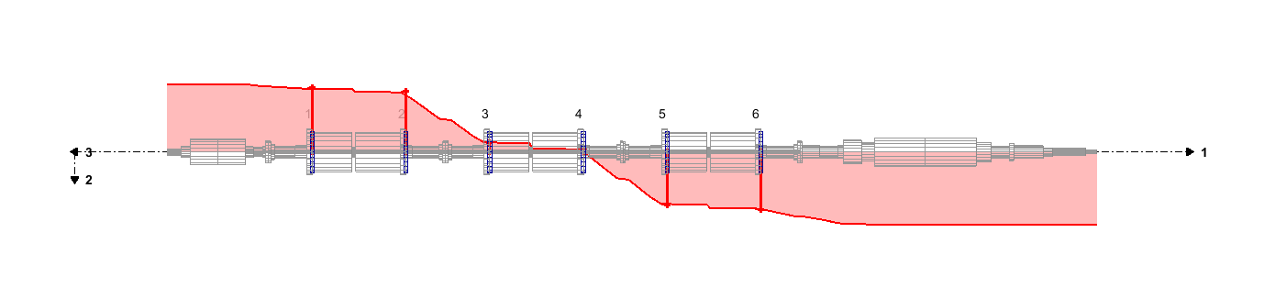
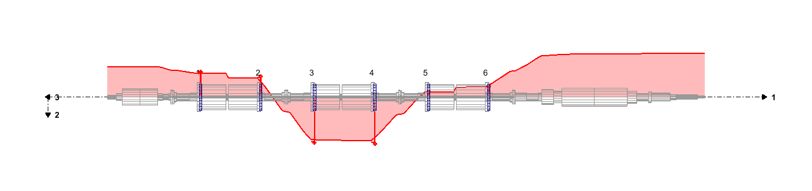
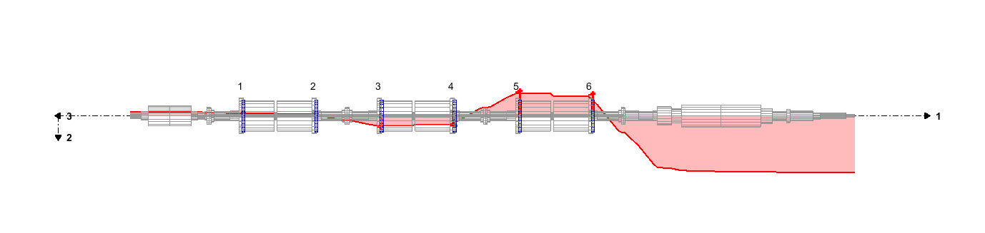
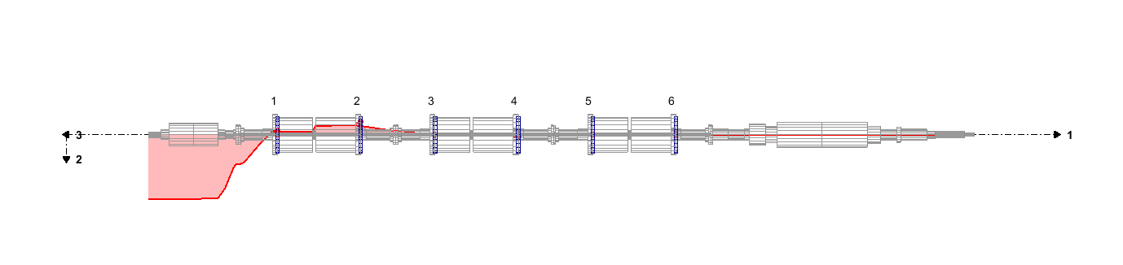
Torsional Natural Frequencies, Modes and Damping of a Turbogenerator
Lowest Torsional Natural Frequencies and Modes of OL3-Turbogenrator
5.9 Hz
10.9 Hz
14.6 Hz
24.0 Hz
Torsional Natural Frequencies: f_{M}^{j} = ω_{M}^{j} / 2 $π$ Hz (j = 1, 2…4)
Mode Shapes of the Shaft Train: φ_{M}^{j}

Slide 10
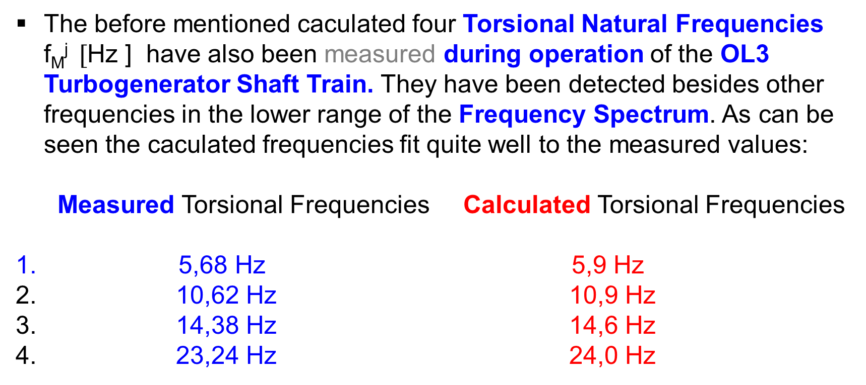
Torsional Natural Frequencies, Modes and Damping of a Turbogenerator
Measurement of the Lowest Torsional Natural Frequencies of OL3
The before mentioned caculated four Torsional Natural Frequencies f_{M}^{j} $[$Hz ] have also been measured during operation of the OL3 Turbogenerator Shaft Train. They have been detected besides other frequencies in the lower range of the Frequency Spectrum. As can be seen the caculated frequencies fit quite well to the measured values:
Measured Torsional Frequencies Calculated Torsional Frequencies
5,68 Hz 5,9 Hz
2. 10,62 Hz 10,9 Hz
3. 14,38 Hz 14,6 Hz
4. 23,24 Hz 24,0 Hz

Slide 11
Torsional Natural Frequencies, Modes and Damping of a Turbogenerator
Measurement of the Lowest Torsional Natural Frequencies of OL3
5,676 Hz (5,9 Hz)
10,62 Hz (10,9 Hz)
14,377 Hz (14,6 Hz)
23,238 Hz (24,0 Hz)

Slide 12
Torsional Natural Frequencies, Modes and Damping of a Turbogenerator
Estimation of the Mechanical and Electrical Damping
The Excited Torsional Vibrations in case of a Sub Synchronous Resonance depend on the Damping of the coupled Turbogenerator–Electrical Grid System. Positive Damping stabilizes the Vibrations, negative Damping leads to an unstable System with increasing Vibration Amplitudes
The Damping of the overall System consists of two parts:
- The Mechanical Damping of the Turbogerator Shaft Train and
- The Electrical Damping from the Generator and the Grid
The Mechanical Damping of the Shaft Train is small compared to the Electrical Damping. The Mechanical Damping includes Material Damping, Steam Damping and Joint Blade damping.

Slide 13
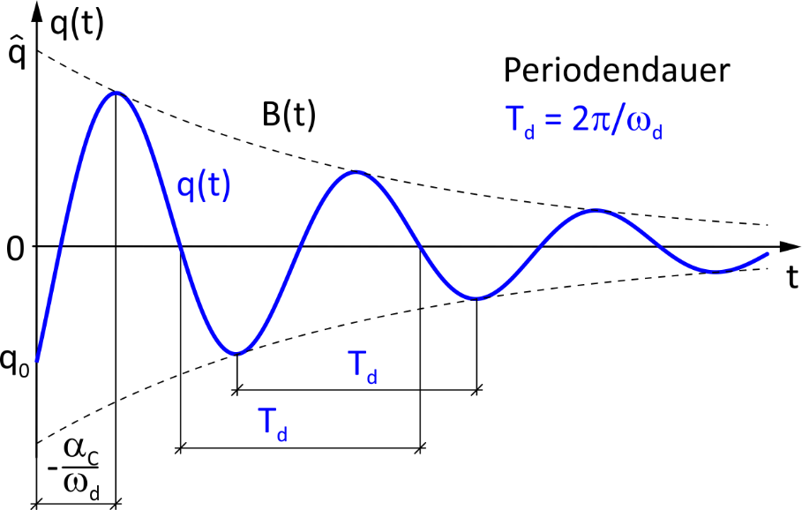
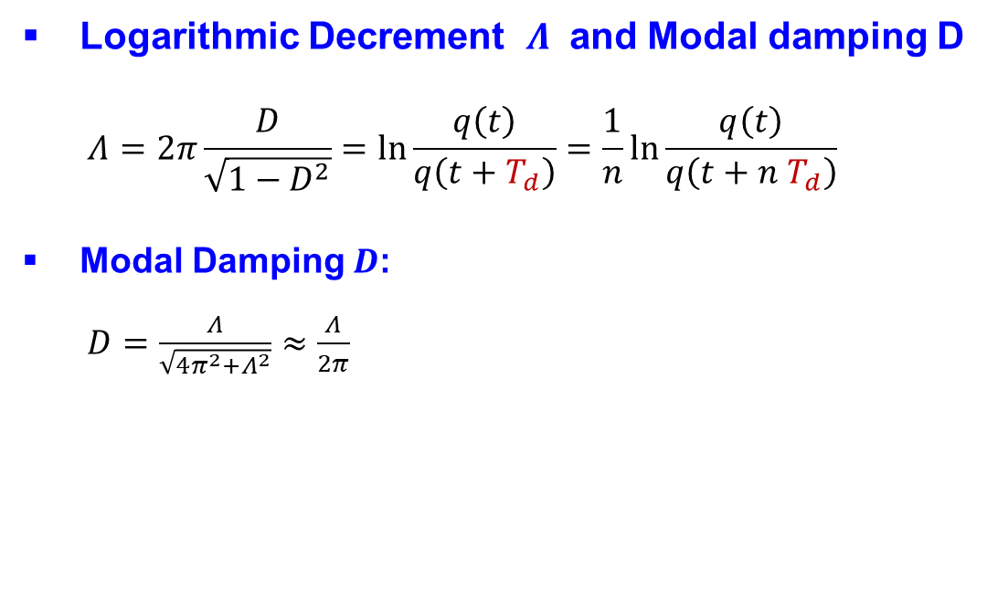
Torsional Natural Frequencies, Modes and Damping of Turbogenerators
Estimation of Mechanical and Electrical Damping - Logarithmic Decrement
Logarithmic Decrement $Λ$ and Modal damping D
    $$Λ=2π\frac{D}{\sqrt{1−D^{2}}}=ln\frac{q\left(t\right)}{q\left(t+T_{d}\right)}=\frac{1}{n}ln\frac{q\left(t\right)}{q\left(t+n{ T}_{d}\right)}$$
Modal Damping $D$:
    $D=\frac{Λ}{\sqrt{4π^{2}+Λ^{2}}}≈\frac{Λ}{2π}$
Notes:
Man nennt den Exponent in der e-Funktion auch das
Logarithmisches Dekrement $Λ:$
$$Λ=2π\frac{D}{\sqrt{1−D^{2}}}=ln\frac{q\left(t\right)}{q\left(t+T_{d}\right)}=\frac{1}{n}ln\frac{q\left(t\right)}{q\left(t+n{ T}_{d}\right)}$$
ein in der Schwingungstechnik oft benutztes Maß für die Dämpfung.
Zwischen dem Dämpfungsgrad D und dem logarithmischen Dekrement besteht de folgende Beziehung:
Dämpfungsgrad $D$:
$D=\frac{Λ}{\sqrt{4π^{2}+Λ^{2}}}≈\frac{Λ}{2π}$

Slide 14
Torsional Natural Frequencies, Modes and damping of Turbogenerators
Estimation of Mechanical Damping without Electric load at OL3

Slide 15
Torsional Natural Frequencies, Modes and Damping of Turbogenerators
Estimation of Mechanical and Electrical Damping at OL3 Turbogenerator
Modal Damping in % with and without Electrical Load

Slide 16
Torsional Natural Frequencies, Modes and Damping of Turbogenerators
Estimation of the Mechanical and Electrical Damping
Contribution of the Mechanical Turbine Shaft for the total Damping of the system is small.
Modal Damping of the Torsional Modes increases significantly with Electrical Load when Generator is connected to the Grid
Most significant sources of the Damping of Torsional Modes seems to be Generator and the Electrical Grid

Slide 17
Torsional Natural Frequencies, Modes and Damping of Turbogenerators
Estimation of the Mechanical and Electrical Damping
The Electrical Damping from the Grid is always positive, while the negative Electrical Damping is caused by the Electrical part of the Generator.
Therefore: When predicting the Electrical Damping via calculation, the Model of the Electrical part of the Generator has to be very accurate
It has to be considered that the Electrical as well as the Mechanical Damping depend on the Electrical Load of the Turbogenerator.

Slide 18
Lecture II Torsional Vibrations of Turbogenerators due to SSR
Mechanical Model for Torsional Vibrations of a Turbogenerator
Torsional Natural Frequencies, Modes and Damping of a Turbogenerator
Methods to predict Sub Synchronous Resonance
Monitoring of Torsional Vibrations and SSR – Incidents
Numerical Estimation of Torsional Vibration Torques and Stresses
Countermeasures to Control SSR- Problems

Slide 19
Methods to predict Sub Synchronous Resonance
General Overview
Different Methods exist in order to predict the occurence of the Sub Synchronous Resonance. Two of the most important ones are briefly described in the following:
Nonlinear Time Domain Analysis for the complete coupled system with all components.
Analysis of the Passive frequency dependent Impedance Function: Voltage/Current in order to determine the Electrical Natural frequencies f_{E}^{i} of the Grid and the Electrical part of the Generator. Evaluation of the relation of f_{E}^{i} to f_{M}^{j} and conclusions regarding Sub Synchronous Resonance.

Slide 20
Methods to predict Sub Synchronous Resonance
Nonlinear Time Domain Analysis for the complete coupled System
For a detailed investigation of the Sub Synchronous Resonance the different
subsystems should be considered as a coupled system, consisting of the
Mechanical and the Electrical Components of the Turbogenerator and the
Electrical Grid, including all Resistances and Reactances.
The best investigation to study the SSR phenomenon is to perform a Nonlinear
Time Domain Analysis for the complete coupled system with all components.
The next figure shows again, how the Generator and the Shaft Train are
coupled with the Electrical Network.

Slide 21
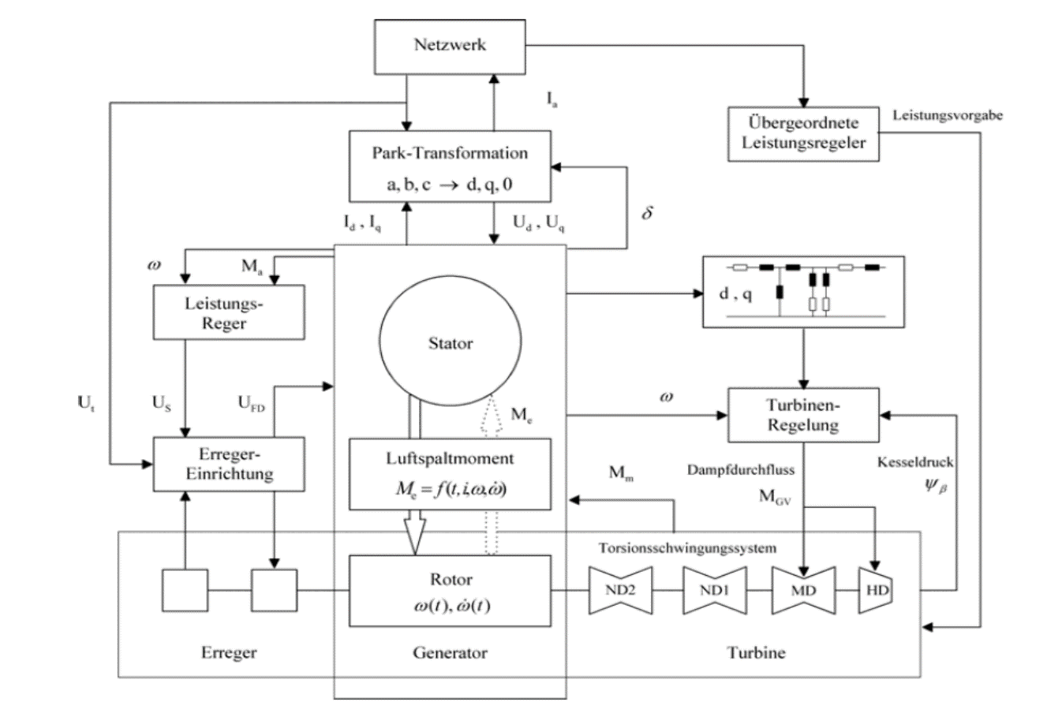
Methods to predict Sub Synchronous Resonance
Non Linear Analysis in the Time Domain for the complete coupled System
Electrical Grid
Electrical
Components of
Turbogenerator
Mechanical
Components of
Turbogenerator

Slide 22
Methods to predict Sub Syncronous Resonance
Non Linear Time Domain Analysis for the complete coupled System
Electrical Grid
Electrical
Components of
Turbogenerator
Mechanical
Components of
Turbogenerator

Slide 23
Methods to predict Sub Synchronous Resonance
Available Simulation Programs for Sub Synchronous Resonance
Simulation Programs are available to fulfill this task. They allow the calculation of the Energy Exchange processes in such complicated coupled systems. Some of these programs are Netomac, PSS/E, DIgSilent and EMPT.
The Exchange processes can be determined in the Time domain as well as in the Frequency domain.
The coupling between the Electrical and the Mechanical system components happens in the Air Gap of the Generator via the Air Gap Torque

Slide 24
Methods to predict Sub Synchronous Resonance
Impedance Function of the Passive Electrical Grid
The investigation of the Impedance Function of the passive Electrical System of the Grid together with the Electrical part of the Generator is a suited method to predict the possible occurence of an SSR event.
The Electrical Resonance Frequencies, that means the Electrical natural frequencies f_{E}^{i} of the Electrical Components (Grid and Generator) can be determined at frequencies, where the Amplitude of the Impedance Function is Zero or has a Minimum (see next slides)
A typical Impedance scan of the Finish Grid close to the OL3 Turbogenerator is shown in the next slide, where the Impedance is defined from the generator terminals into the network. Detection of f_{E}^{i} ~15,5 Hz.

Slide 25
Methods to predict Sub Synchronous Resonance
Impedance Function of the Finish Grid close to the OL3 Turbogenerator

Slide 26
Methods to predict Sub Synchronous Resonance
Estimation of the Mechanical and Electrical Damping by calculations
If all mechanical and electrical parameters are well known, even with their nonlinear characteristics, the Model for the complete coupled system can be used to determine the vibration behavior by calculation.
The vibration response signals in the Time Domain can then be used to determine the Modal Damping via the Logaritmic dekrement, which can be used for different time periods. Due to nonlinear effects the damping may vary versus the time due to different nonlinear effects, e.g. dependent on the load.
If possible, the mechanical as well as the electrical damping should also be determined by measurements. The measured signals in the time domain can then again be used to determine the Modal Damping via the Logarithmic Decrement, as shown before.

Slide 27
Lecture II Torsional Vibrations of Turbogenerators due to SSR
Mechanical Model for Torsional Vibrations of a Turbogenerator
Torsional Natural Frequencies, Modes and Damping of a Turbogenerator
Methods to predict Sub Synchronous Resonance
Monitoring of Torsional Vibrations and SSR – Incidents
Numerical Estimation of Torsional Vibration Torques and Stresses
Countermeasures to Control SSR- Problems

Slide 28
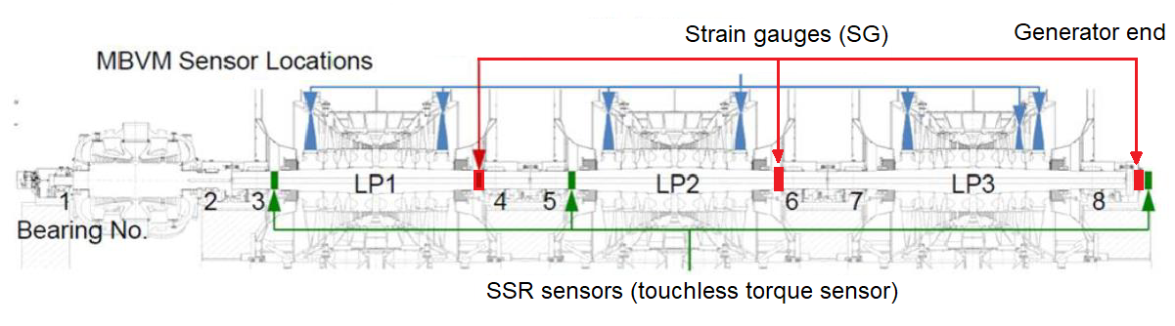
Monitoring of Torsional Vibrations and SSR - Incidents
Touchless SSR Sensors and Strain Gauges on the OL3 Shaft Train
Arrangement of touchless Sensors SSR (Siemens): Locations 3, 5, 8
Arrangement of Strain Gauges SG (VTT) : Locations 4, 6, 8
Both Sensor types measure stresses (Mpa) or torques (Nm)

Slide 29
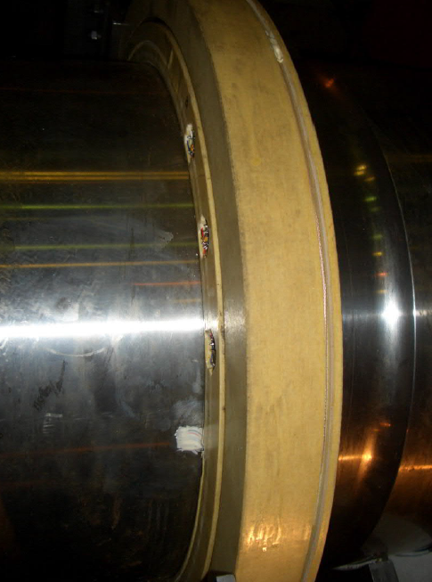
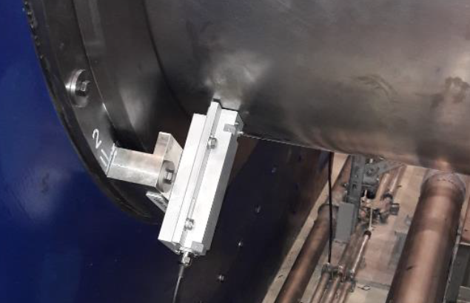
Monitoring of Torsional Vibrations and SSR - Incidents
Contactless SSR Sensors and Strain Gauges on the Shaft Train
Sensors SSR
(Siemens)
Strain gauges SG
(VTT)

Slide 30
Sensors SSR
(Siemens)
Strain gauges SG
(VTT)

Slide 31
Monitoring of Torsional Vibrations and SSR - Incidents
Siemens Touchless SSR Torque Sensor
Stresses up to
1000 Mpa
Frequency range
0-200 Hz
The Touchless Torque Sensor measures the static and dynamic torques (stresses) at the rotating turbogenerator shaft train. It is based on the influence of mechanical stresses on the magnetic permeability of ferromagnetic materials.

Slide 32
Monitoring of Torsional Vibrations and SSR - Incidents
Measured Torsional Natural Frequencies of OL3 (Monitorig)
5,676 Hz (5,9 Hz)
10,62 Hz (10,9 Hz)
14,377 Hz (14,6 Hz)
23,238 Hz (24,0 Hz)

Slide 33
Monitoring of Torsional Vibrations and SSR - Incidents
Monitoring of the SSR incidents on 5.1.23 by SSR sensors at loc. 3, 5, 8
M
Loc.8
Loc.5
Loc.3

Slide 34
Monitoring of Torsional Vibrations and SSR - Incident
Monitoring of the OL3-SSR event 1 on 5.1.23 by SSR1 sensor at loc.8
stress
stress
time
time
frequency
frequency

Slide 35
Monitoring of Torsional Vibrations and SSR - Incident
Monitoring of the OL3-SSR event 2 on 5.1.23 by SSR1 sensor at loc.8
stress
time
frequency
frequency

Slide 36
Lecture II Torsional Vibrations of Turbogenerators due to SSR
Mechanical Model for Torsional Vibrations of a Turbogenerator
Torsional Natural Frequencies, Modes and Damping of a Turbogenerator
Methods to predict Sub Synchronous Resonance
Monitoring of Torsional Vibrations and SSR – Incidents
Numerical Estimation of Torsional Vibration Torques and Stresses
Countermeasures to Control SSR- Problems

Slide 37
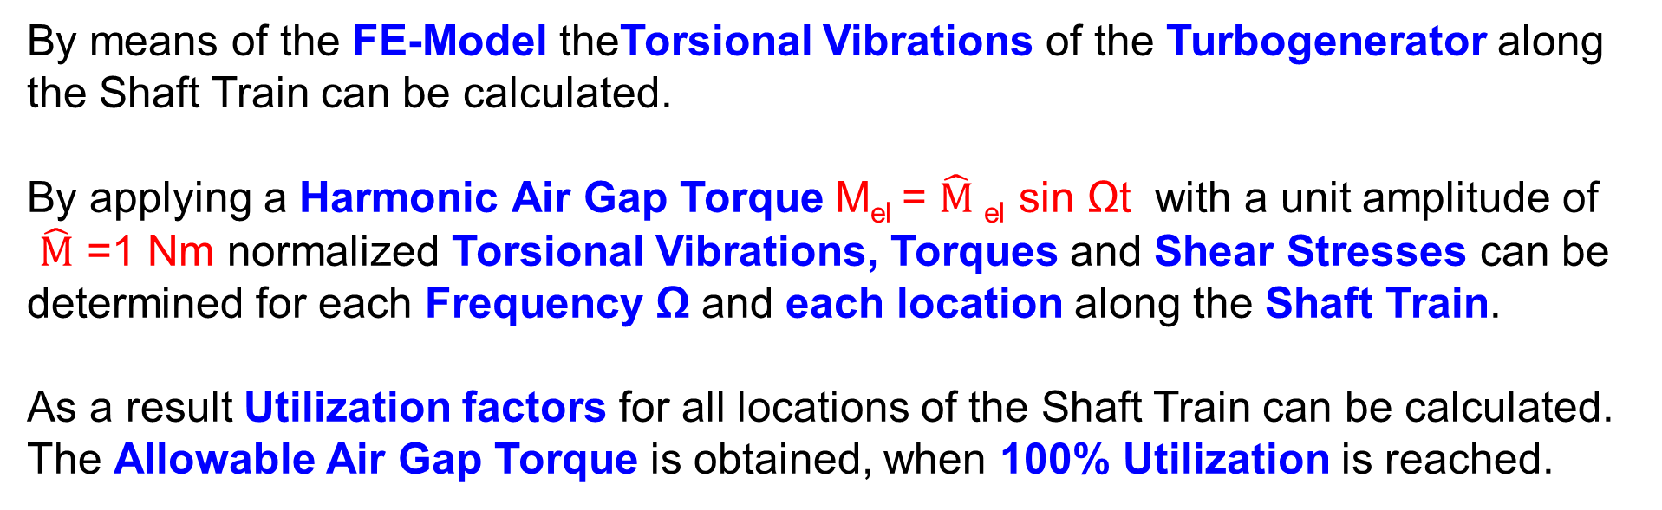
Numerical Estimation of Torsional Vibration Torques and Stresses
Allowable Excitation Torque in the Air Gap of the OL3 Turbogenerator
M_{el}
HPT LPT1 LPT2 LPT3 GEN EXC
By means of the FE-Model theTorsional Vibrations of the Turbogenerator along the Shaft Train can be calculated.
By applying a Harmonic Air Gap Torque M_{el} = $\hat{M}$_{el} sin Ωt with a unit amplitude of
$\hat{M}$ =1 Nm normalized Torsional Vibrations, Torques and Shear Stresses can be determined for each Frequency Ω and each location along the Shaft Train.
As a result Utilization factors for all locations of the Shaft Train can be calculated. The Allowable Air Gap Torque is obtained, when 100% Utilization is reached.

Slide 38
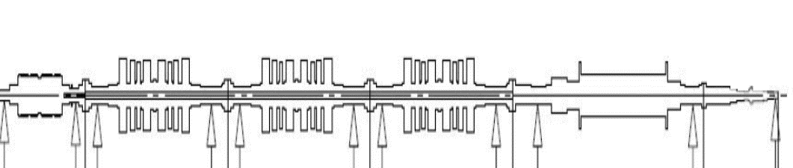
Numerical Estimation of Torsional Vibration Torques and Stresses
Allowable Excitation Torque in the Air Gap of the OL3 Turbogenerator
Procedure: Input of a Harmonic Torque with Unit amplitude 1 Nm from 0 to 50 Hz
M_{el}
IS
Calculate dyn. torque for every element
Include Notchfactors
Calculate dyn. torsional stress τ_{Harmonic}
Component Limits
LPT3, IS, GEN
Compare with allowable tors. stress τ_{Allowable}
Utilization factor
Recalculate Excitation Torque that produces an utilization factor of 100%
Result: Allowable Excitation Air Gap Torque

Slide 39
Numerical Estimation of Torsional Vibration Torques and Stresses
Allowable Excitation Torque in the Air Gap of the OL3 Turbogenerator
M_{el}
HPT LPT1 LPT2 LPT3 GEN EXC
The Allowable Excitation Torque M_{el} in the Air Gap of the OL3 Turbogenerator
and the corresponding Shear Stress Distribution can be determined also for each Torsional Natural Frequency.
The OL3-Turbogenerator Mode Shape with Natural Frequency of 14,4 Hz is
a critical mode regarding Sub Synchronous Resonance. The most loaded area with high stresses is in the Intermediate Shaft between the LPT3 and GEN.

Slide 40
Lecture II Torsional Vibrations of Turbogenerators due to SSR
Mechanical Model for Torsional Vibrations of a Turbogenerator
Torsional Natural Frequencies, Modes and Damping of a Turbogenerator
Methods to predict Sub Synchronous Resonance
Monitoring of Torsional Vibrations and SSR – Incidents
Numerical Estimation of Torsional Vibration Torques and Stresses
Countermeasures to Control SSR- Problems

Slide 41
Countermeasures to Control SSR-Problems
General Overview
Countermeasures to Control Sub Synchronous Resonance Problems can be subdivided into:
Protection Systems outside the Power Plant - in the Electrical Grid System
Protection Systems inside the Power Plant
- Grid Disconnection
- Electrical Protection without Grid Disconnection
- Mechanical Protection without Grid Disconnection
In this Overview we consider mainly Protection Systems inside the Power Plant

Slide 42
Countermeasures to Control SSR-Problems
Protection Systems outside the Power Plant – in the Electrical Grid System
Some possibilities of protection systems outside the Power Plant, that means in the Electrical Grid System are:
- Static Blocking Filter
- Bypass Damping Filter
- Dynamic Filter
- Change of the grade of the compensation in the Grid
- Thyristor controlled in Series compensation
They will not be considered in this presentation. More detailed information can
be found in the publication:
„Countermeasures to Subsynchronous Resonance Problems“
IEEE Transactions on Power Apparatus and Systems, Vol. PAS-99, No.5,
Sept./Oct. 1980

Slide 43
Countermeasures to Control SSR-Problems
Protection Systems inside the Power Plant – Grid Disconnection
Protection Systems inside the Power Plant – by Grid Disconnection:
One concept for the protection of the Turbogenerator Shaft Train to SSR-
Problems is the Grid Disconnection.
By permanent Monitoring and Evaluation of
- the Torsional Vibrations and Stresses or
- the Stator Voltages and Currents
the Turbogenerator will be disconnected from the Grid, when critical values
have been reached.

Slide 44
Countermeasures to Control SSR - Problems
General Vibration Control Measures by Passive, Semi-Active and Active Control
Vibration Control Measures | Without Energy Conversion | With Energy Conversion
 | Passive | semi-Active | Active
Reduction of Excitation
System Tuning
Damping
Vibration Absorber
Isolation of disturbance
Isolation to protect the receiver
Extended Solutions
Conventional Solution
Increase of:
Effectiveness, Complexity,
more Solution Variants

Slide 45
Vibration Control Measures | Without Energy Conversion | With Energy Conversion
 | Passive | semi-Active | Active
Reduction of Excitation
System Tuning
Damping
Vibration Absorber
Isolation of disturbance
Isolation to protect the receiver
Extended Solutions
Conventional Solution
Increase of:
Effectiveness, Complexity,
more Solution Variants

Slide 46
Countermeasures to Control SSR-Problems
Protection Systems inside the Power Plant – Electrical Protection
In the following slides two examples of Protection Systems inside the Power Plant are presented. The first example is a Electrical Protection with application of Active Damping supplied to the Generator via a Converter.The second example is a Mechanical Protection working with a Vibration Absorber, attached to the Turbogenerator Shaft Train.
These are only two possibilities of Protection Systems. Further Countermeasures to Sub Synchronous Resonance Problems can be found in the literature. The recommended old IEEE Publication contains many recommendations:
_______________________________________________________
„Countermeasures to Sub Synchronous Resonance problems“
IEEE Transactions on Power Apparatus and Systems, Vol.PAS-99,
No. 5 Sept./Oct. 1980

Slide 47
In the following slides two examples of Protection Systems inside the Power Plant are presented. The first example is a Electrical Protection with application of Active Damping supplied to the Generator via a Converter.The second example is a Mechanical Protection working with a Vibration Absorber, attached to the Turbogenerator Shaft Train.
_______________________________________________________

Slide 48
Contermeasures to Control SSR-Problems
Active Damping via Air Gap Torque by means of an Electronic Power Converter
Vibration Control Measures | Without Energy Conversion | With Energy Conversion
 | Passive | semi-Active | Active
Reduction of Excitation
System Tuning
Active Damping |  |  | Active Damping via Air Gap Torque with Electronic Power Converter
Vibration Absorber
Isolation of disturbance
Isolation to protect the receiver
Increase of:
Effectiveness, Complexity,
more Solution Variants

Slide 49
Countermeasures to Control SSR-Problems
Protection Systems inside the Power Plant – Electrical Protection
In the publication from T. Zöller, et al: Damping of torsional vibrations by a
power electronic grid component“ an investigation is presented, how to apply Active Damping into the Turbogenerator Shaft Train to increase the overall damping of the System. The idea is to influence the Air Gap Torque via the Active Power of the Generator.
_______________________________________________________
Publication: T. Zöller, e.al. Dämpfung von Torsionsschwingungen mittels einer leistungselektronischen Netzkomponente.
ETG Kongress 2009 FT 1+2, 27-28. Oct. 2009 in Düsseldorf

Slide 50
Countermeasures to Control SSR-Problems
Protection Systems inside the Power Plant – Electrical Protection
A dynamic control of the electrical active power of a Turbogenerator is not an easy task. However, a solution would be possible by coupling the Generator to the Grid via a Convertor. But this is economically not very efficient, if the Converter is designed for the full power of the Generator.
In the mentioned publication a solution is presented by connecting the Electronic Power Converter (Stromrichter) parallel to the Generator. This additional Grid component: Parallel Connected Damper Circuit – PCDC fulfills the task to supply the required Damping Power at the cutting point Grid/Generator to the Generator. It can be considered as a Electrical Protection System to the SSR Problem.
A scematic overview of the overall system is presented in the next slide.

Slide 51
Countermeasures to Control SSR-Problems
Protection Systems inside the Power Plant – Electrical Protection

Slide 52
Countermeasures to Control SSR-Problems
Protection Systems inside the Power Plant – Electrical Protection
Main Steps in the Procedure:
Measure the Torsional Vibrations and Signal Processing
Calculation of the required Damping Power for the Control
Converter Controller Signal transferred to the Converter
Converter delivers the required Damping Power to the Generator
For Damping of Periodic Excitations the required Power is very small.
For Damping of Transient Excitations the required Power can be higher
for a short period.
More details are described in the publication.

Slide 53
Countermeasures to Control SSR-Problems
Protection Systems inside the Power Plant – Electrical Protection
In the PhD Thesis: T. Zöller – „Aktive Dämpfung von Torsionsschwingungen in Wellensträngen von Kraftwerksturbosätzen“ Karlsruhe Institute of Technology (KIT) – 2011 more results can be found.
The next slide shows a Test Rig, which was used to demonstrate the Active Damping. The following slide presents, how the Active Damping reduces the Torsional Vibrations of a Sub Synchronous Resonance by means of a LQG-Controller.

Slide 54
Countermeasures to Control SSR-Problems
Protection Systems inside the Power Plant – Electrical Protection

Slide 55
Countermeasures to Control SSR-Problems
Protection Systems inside the Power Plant – Electrical Protection

Slide 56
Countermeasures to Control SSR-Problems
Vibration Absorber with Damping – Semi-Active Adjustment of Stiffness
Vibration Control MeasuresM | Without Energy Conversion | With Energy Conversion
 | Passive | semi-Active | Active
Reduction of Excitation
System Tuning
Damping
Vibration Absorber with Damping |  | Semi-Active Adjustment of the Stiffness
Isolation of disturbance
Isolation to protect the receiver
Increase of:
Effectiveness, Complexity,
more Solution Variants

Slide 57
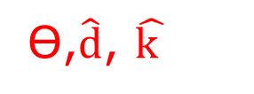
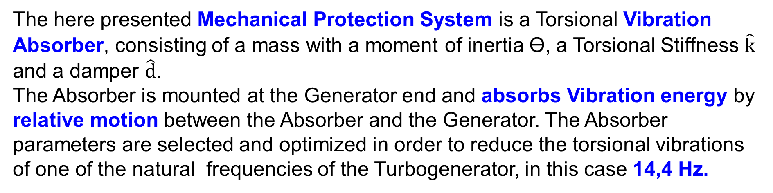
Countermeasures to Control SSR-Problems
Protection Systems inside the Power Plant – Mechanical Protection
Ɵ₁ k₁ Ɵ₂ k₂ Ɵ₃ k₃ Ɵ₄ k₄ Ɵ₅
Ө,$\hat{d}$, $\hat{k }$
HPT LPT1 LPT2 LPT3 GEN MABS
Turbogenerator Shaft Train Torsional Vibration Absorber
The here presented Mechanical Protection System is a Torsional Vibration
Absorber, consisting of a mass with a moment of inertia Ө, a Torsional Stiffness $\hat{k}$
and a damper $\hat{d}$.
The Absorber is mounted at the Generator end and absorbs Vibration energy by relative motion between the Absorber and the Generator. The Absorber parameters are selected and optimized in order to reduce the torsional vibrations of one of the natural frequencies of the Turbogenerator, in this case 14,4 Hz.

Slide 58
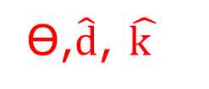
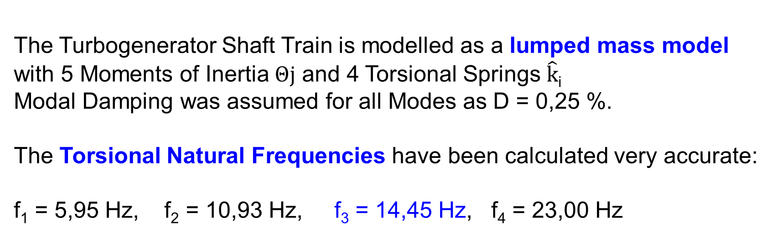
Countermeasures to Control SSR-Problems
Protection Systems inside the Power Plant – Mechanical Protection
Ɵ₁ k₁ Ɵ₂ k₂ Ɵ₃ k₃ Ɵ₄ k₄ Ɵ₅
Ө,$\hat{d}$, $\hat{k }$
HPT LPT1 LPT2 LPT3 GEN MABS
Turbogenerator Shaft Train Torsional Vibration Absorber
The Turbogenerator Shaft Train is modelled as a lumped mass model
with 5 Moments of Inertia $Θj$ and 4 Torsional Springs $\hat{k}$_{i}
Modal Damping was assumed for all Modes as D = 0,25 %.
The Torsional Natural Frequencies have been calculated very accurate:
f₁ = 5,95 Hz, f₂ = 10,93 Hz, f₃ = 14,45 Hz, f₄ = 23,00 Hz

Slide 59
Countermeasures to Control SSR-Problems
Protection Systems inside the Power Plant – Mechanical Protection
HPT LPT1 LPT2 LPT3 GEN ABS
The red Frequency Response Function (with Absorber) between the torsional Vibration at the intermediate Shaft and the Air Gap Torque shows a strong reduction at the Resonance Frequency of 14,4 Hz in comparison to the blue FRF (without Absorber)

Slide 60
Countermeasures to Control SSR-Problems
Protection Systems inside the Power Plant – Mechanical Protection
Turbogenerator Shaft Train Torsional Vibration Absorber
HPT LPT1 LPT2 LPT3 GEN MABS
The additional mass of the Vibration Absorber is about 5000 kg.The Absorber
has an outer diameter of about 2 m and its axial length is 0,5 m.
Critical Remarks:It is of course difficult to realize the subsequent installation of
such an Absorber System and design changes with a optimal coupling to the shaft
system would be necessary. Furthermore It has to be checked, whether there is
enough space for the additional component.

Slide 61
Energiforsk Project: Lectures in the Power Plants
Fortum (Helsinki), TVO (Olkiluoto), Jan./Febr. 2024
Annual Energiforsk Seminar (10.11.21)
Vorlesungen Mechatronik im Wintersemester
Vibrations of Turbines and Generators in Power Plants
Lecture II Torsional Vibrations of Turbogenerators due to SSR
Rainer Nordmann
Technische Universität Darmstadt

